Slide 1


Stronger Starts
by First 5 California
Powered by Cell-Ed
First 5 Network Webinar

Slide 2

Agenda
Reminder
Introductions
What is Stronger Starts powered by Cell-Ed?
Micro Courses
Coaching
Push Messaging
How to get started
Toolkit Overview
What’s next?
FAQs.

Slide 3

What is Stronger Starts powered by Cell-Ed?
First-of-its-kind trauma-informed
text and audio based lessons,
text-based tips by age & stage,
and live coaching support for caregivers
free - solutions focused - positive framing
designed with input from expert

Slide 4
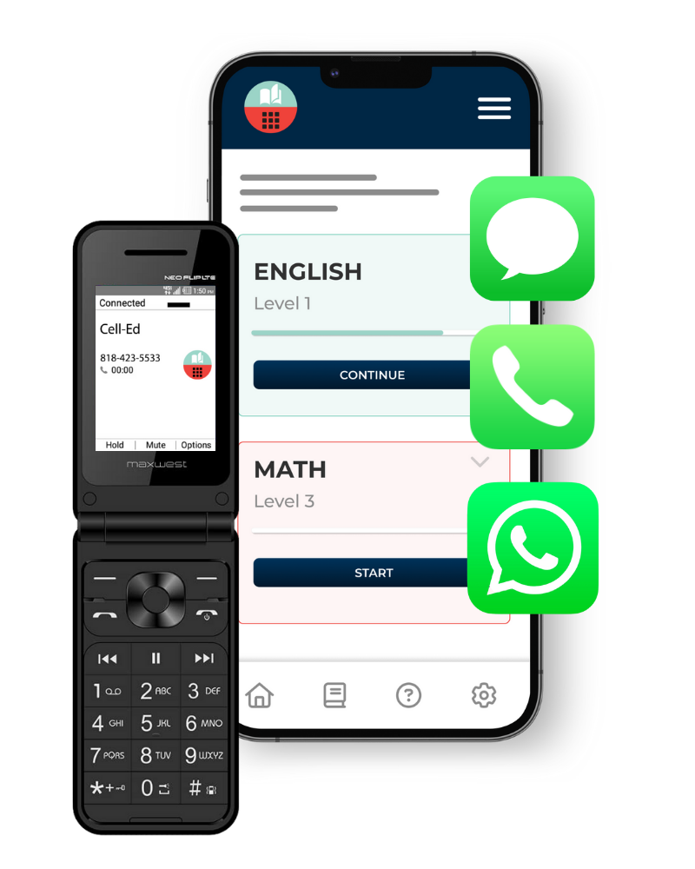

What is Cell-Ed?
Cell-Ed provides a mobile-first solution proven effective to upskill adults worldwide. Cell-Ed delivers education and live coaching support to individuals who need it most.
4X- 6X Higher
Skill Gains
20% +
Higher
Engagement
84%
Faster
Learning Gains
91%
Learner Satisfaction

Slide 5
Why We Exist
1 in 3 adults have essential skill gaps
1 in 2 households lack digital access
<1% of digital solutions designed to address these gaps
Cell-Ed removes these gaps effectively & affordably
Notes:
So many parents need these skills. Limited time.
tips and tricks any parent can use

Slide 6
The Cell-Ed Approach
Widely Accessible no smartphone, internet, or classroom required
Cross Platform to meet learners where they are - phone, tablet, WhatsApp, laptop.
3-minute Lessons as adults learn better in short, easily digestible bursts.
Coaching Support to provide parents with the encouragement and support they require.
Push Content critical information sent to caregivers with busy lives
Proven Effective to deliver 84% faster skills gains and 20%+ higher engagement.
91%
Learner Satisfaction

Slide 7

Stronger Starts Overview
91%
Learner Satisfaction

Slide 8
Why Stronger Starts powered by Cell-Ed
Overcome Barriers
money
time
childcare
transportation
digital access
digital skills
language & literacy
Actionable Tips
relevant
practical
immediate
research based
push content
positive frame
For All Californians
positive parent culture
often homogeneous
values all cultures
honors all perspectives
designed for all regardless of income, race, role, family makeup
91%
Learner Satisfaction

Slide 9
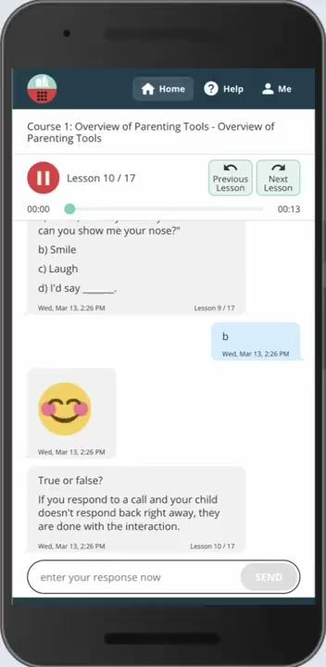
Stronger Starts in Action
91%
Learner Satisfaction

Slide 10

Stronger Starts Courses
Overview of Parenting Tools
Learn four quick parenting tools: taking
a pause, call and response, special time,
the benefits of routine.
Keeping Calm in Challenging Situations
Caregiving is challenging! Learn tools
for you and your child to stay calm
in difficult moments.
Strengthening Bonds with Your Child
Your love and care are so important for your child’s growth. Learn why, and tools to show love and affection to your children.
Building Your Community
Learn about how people in your life can support you with parenting. Learn tools and get more support.
Teaching Your Child Problem-Solving Skills
Your child is learning new things every day.
Take home tools to support your child in building resilience to face all of life’s challenges.
Managing Power Struggles
As a child grows and learns, they will test
the rules. Learn tools to respond consistently in those situations.
Available in three versions: English, Spanish, ELL

Slide 11

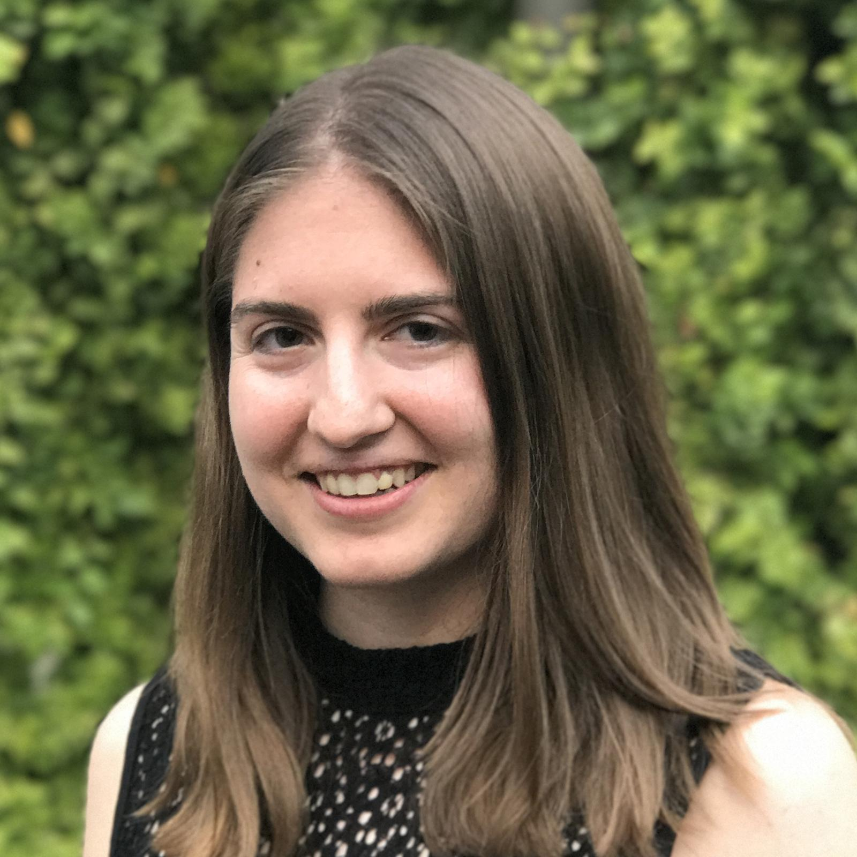
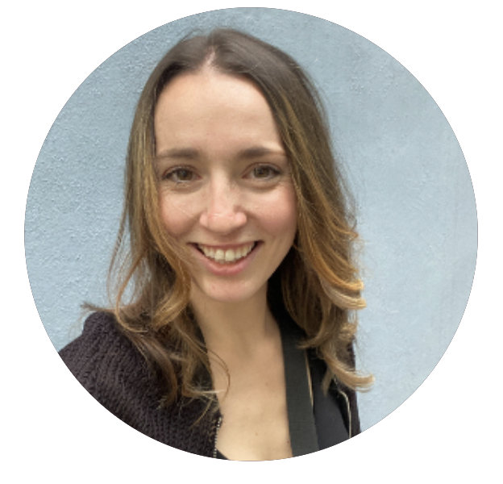
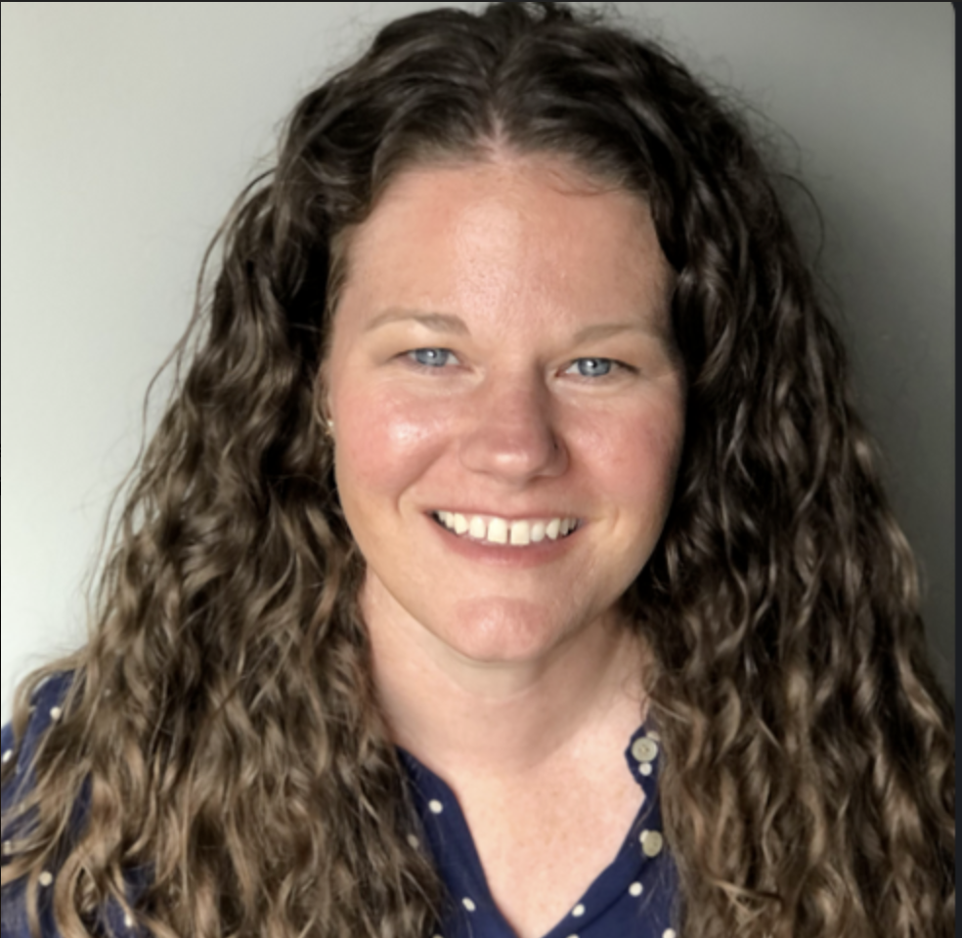
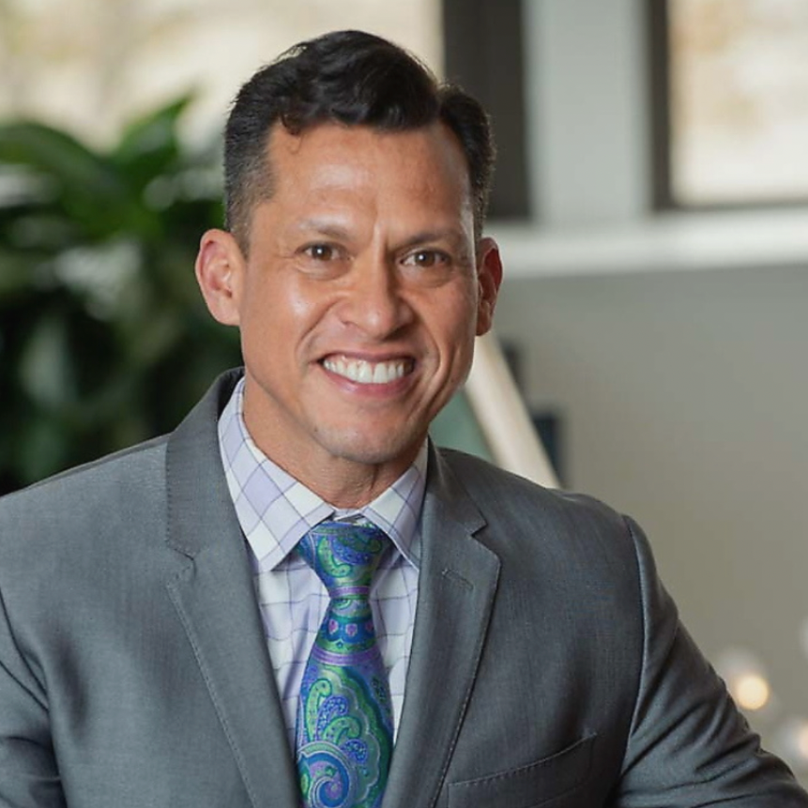

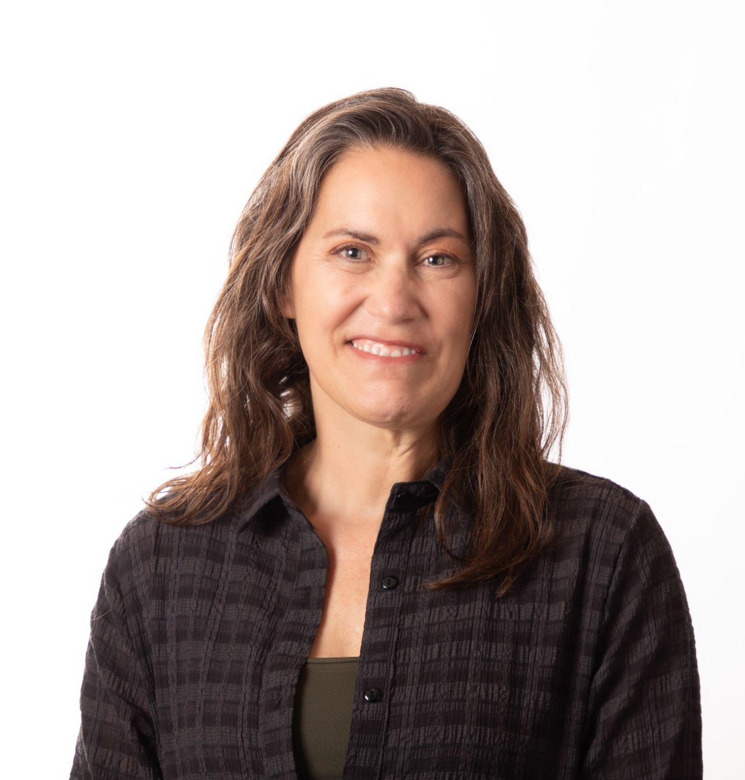
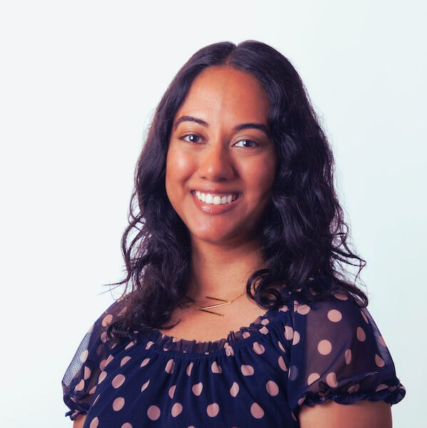
Our Subject Matter Experts
Dr. Nadine Burke Harris
ACE Resource Network, Former CA Surgeon General, Former F5CA Chair
Megan Gomez
Director of Learning Design
Maddie Huerta
Content Project Manager
Dr. Allison Parsons
Senior Research Scientist, Rescue Agency
Ed Center
The Village Well
Katie Horowitz
Director of Program Design
Joy Thomas
Director of Communications & Community Engagement, ACE Resource Network
Amy Davis
Cognitive Behavioral Specialist
Neera Maru
VP of Programs
Notes:
So many parents need these skills. Limited time.
tips and tricks any parent can use

Slide 12

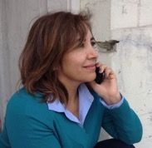
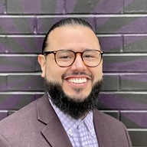
Coaching
Supporting parents and caregivers when they need it most
Live coaches in English and Spanish
Each user paired with a coach who stays
with them through their time on Cell-Ed
Available in English and Spanish
Connect and Support
Coaches encourage users to set goals, understand their motivations, and connect caregivers to resources.
Trauma-Informed and Trained
Cell-Ed coaches are experts in health and wellness coaching, with International Coaching Federation (ICF) and National Board of Health and Wellness Coaching (NBHWC) accredited coach training.

Slide 13
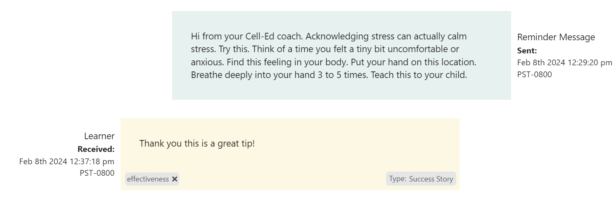
Coaching Support
Example Conversation

Slide 14
Push Messaging
Hyper relevant messaging at your fingertips
Based on age and stage of child
Messages are customized for the age and stage of the child. This provides specific skills that parents can implement right away and see immediate benefit.
Customized based on persona
Parents have unique motivations and values.. Messages are tailored to each parents’ persona.
Connect with resources
Messages can be used to direct parents to specific additional resources in their area.

Slide 15
Sample Texts Age 0-1
Hi from your Cell-Ed coach. This is the beginning of your Stronger Starts parenting tips for your child age 0-1. Babies can imitate expressions as early as being 10 minutes old. This is a strong instinct your baby has called 'mirroring' and it's the strongest way babies have to learn.
Hi from your Cell-Ed coach. Eye contact develops a baby’s brain by focusing about 8 to 12 inches away. This is the distance between a baby cuddled at the breast and a mother (or father’s) face. Your baby will look for and connect with your gaze right from birth.

Slide 16
Sample Texts Age 2-3
Hi from your Cell-Ed coach. This is the beginning of your Stronger Starts parenting tips for your child age 2-3. At this age your child will enjoy contributing to the family with matching games. For example your toddler can find all the socks in the laundry and then match the socks. Helping the family in this way develops their brain and their sense of belonging and contribution.
Hi from your Cell-Ed coach. Another fun horsey activity is “falling.” You start by sitting upright with your toddler on your lap and then “fall” slowly backwards with your toddler safely lying on your chest. Repeat this. Your child may start pushing back on your chest to tell you he wants you to fall back more. If you notice this, you can say, “You want more? Ready, set, go!”

Slide 17
Sample Texts Age 4-5
Hi from your Cell-Ed coach. This is the beginning of your Stronger Starts parenting tips for your child age 4-5. The more your child can name BIG EMOTIONS the more they process emotions. Here's an example:
Adult:(sees child upset) You seem upset. What's up?
Child: Jamal didn't share the jump rope.
Adult: Maybe you are feeling sad or frustrated?
Child: It's not fair!
Adult: Frustration can feel hot. Let's jump up and down together to cool down.
Hi from your Cell-Ed coach. Role-playing activities are a fun way to teach your child empathy, social and emotional skills. Try acting out different scenarios where they can practice taking turns, sharing toys, playing together, and listening. These experiences will prepare your child for real-life social situations.

Slide 18
Getting Started
Simple steps and resources to share with parents and caregivers

Slide 19
Our Ask of You
.
Spread the word!
Get as many parents and caregivers connected in the next two months:
Try it out
Sign up for the Toolkit
Encourage Your Networks
    To to sign up for the toolkit
    To sign up their communities
Let us know how we can support you - nuri@cell-ed.com

Slide 20
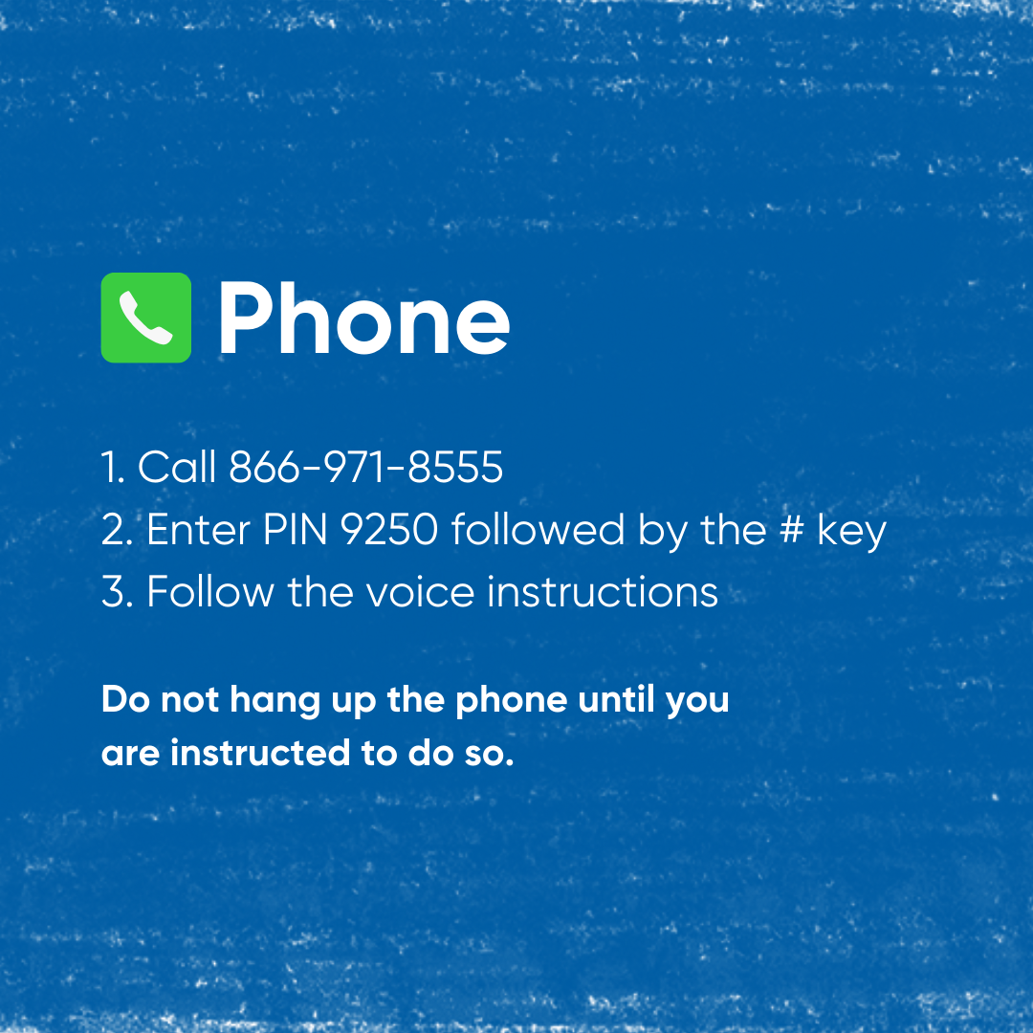
Call on Any Cell Phone

Slide 21
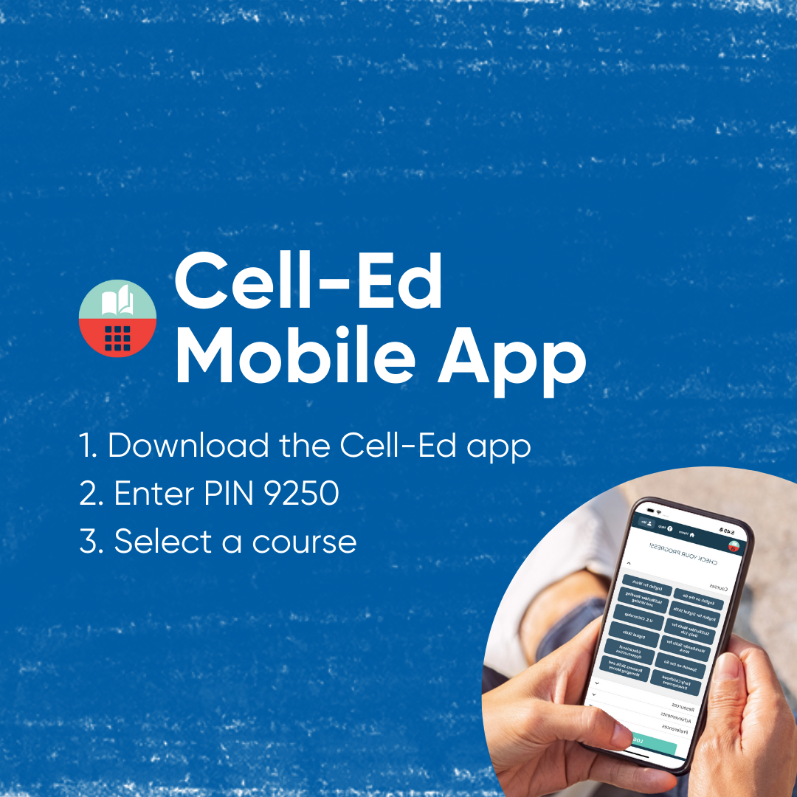
Call on Any Cell Phone

Slide 22

Call on Any Cell Phone

Slide 23

Call on Any Cell Phone

Slide 24

Your Toolkit
The First Five toolkit is home to the materials to
Familiarize yourself with the program
Spread the word
Support your networks
Live coaching is available until 6/30/2024
Courses will remain available after 6/30/2024
To access the toolkit, you will use the following link
If you need any additional support,
email us at nuri@cell-ed.com or use help form in toolkit

Slide 25

Questions?

Slide 26

Thank you!

Slide 27
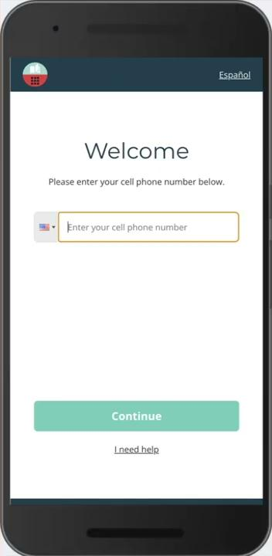
Onboarding Demo

Slide 28
A first of its kind
Courses-Coaching-Micro-Learning for Parents and Caregivers
Courses
Six text and audio based trauma informed parenting courses in English, Spanish, and ELL
Includes ACEs and Toxic Stress
Positive and supportive
Designed with First 5 best practices, cognitive behavioral scientists, parents, and education experts
Push Messages
Based on age and stage of child
Customized based on parent and caregiver persona and personal motivation
Connect with resources
Coaching:
one on one live coaching in English and Spanish
Celebrate progress
Answer questions
Set goals

